Slide 1
MOOC Rec v2
System Requirement Specification Presentation

Slide 2
Feature comparison
Features | Class Central | My MOOC | MOOCRec | MOOCRec V2 Proposed Solution
Direct learning style identification | ✗ | ✗ | ✗ | ✓
Video Production Styles | ✗ | ✗ | ✓ | ✓
Complex and mixed video production styles | ✗ | ✗ | ✗ | ✓
Identify the spoken language of the presenter | ✗ | ✗ | ✗ | ✓
Search filter based on specific keywords / topics | ✗ | ✗ | ✓ | ✓
User profile and dashboard | ✗ | ✗ | ✓ | ✓
Online discussion forums analysis and extraction of sentiments of forum posts for better MOOC recommendations | ✗ | ✗ | ✗ | ✓

Slide 3
MOOC Rec v2
SERVICE ORCHESTRATOR FOR PARALLEL CLASSIFICATION

Slide 4
Knowledge Gap
Problems/Limitations/Potential Improvements – In Mooc Rec v1
Traditional workloads are single-threaded and does not utilize memory and CPU to the fullest.
Problems/Limitations/Potential Improvements – In General
GPU based classification is expensive.
Process tends not to be persistent.
Solution
Run multiple instances of the same classifier in the same server; feed different data to each instance.

Slide 5
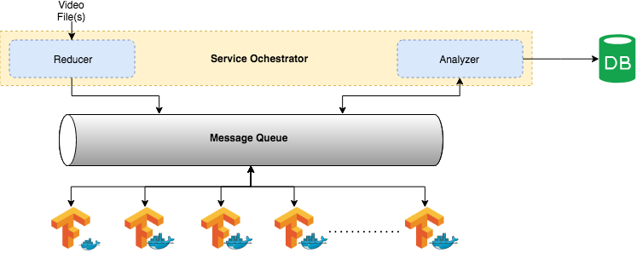
System Design

Slide 6
Functional Requirements
Mark
Mark logical video chunks of each video file.
Classify
Classify logical video chunks using a provided classifier.
Analyze
Analyze the output given by service workers after classification.
Derive
Derive at a single conclusion for each video file.

Slide 7
External Interfaces
Hardware Interfaces
100Mbit network interface.
SSD based EBS volume of 50GB or more.
At least one EC2 instance with below specifications.
8GB RAM
8GB internal storage for the operating system
4 or more vCPUs
Another EC2 instance for running the DB with below specifications.
16GB RAM
25GB SSD based storage
4 or more vCPUs

Slide 8
External Interfaces
Software Interfaces
Amazon Linux 2 operating system
Python 3.7
Docker
RabbitMQ
TensorFlow
MongoDB
Communication Interfaces
Network connection with Internet Gateway ( Provisioned and managed by AWS )

Slide 9
MOOC Rec v2
Identify users’ preferred learning material type

Slide 10
Knowledge gap
Research problem
MOOCs recommenders like Class central, My MOOC does not identify :
users’ preferred learning style
learning material types that suit each learning style
MOOCRec V1 :
ILS questionnaire consists of 44 questions, hence lengthy
Do not have a proven learning material type to learning style mapping
Solution
Interactive introductory session
Introducing learning material type to learning style mapping : Proven using HCI evaluation techniques.

Slide 11
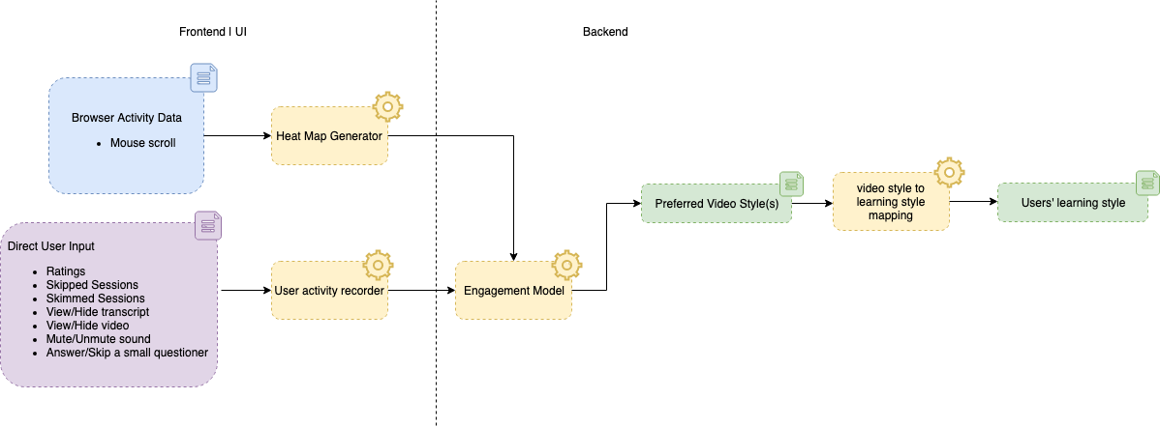
System design

Slide 12
Functional Requirements
Record user activity and interactions.
Active user interactions:
Skip each segment
Rate each segment
View/Hide transcript of each segment
View/Hide video of each segment
Mute/Unmute sound of each video segment
Answer/Skip a small questioner about each segment
Passive user interactions:
Mouse scroll movements
Analyze user engagement
Map learner style and make MOOC recommendations

Slide 13
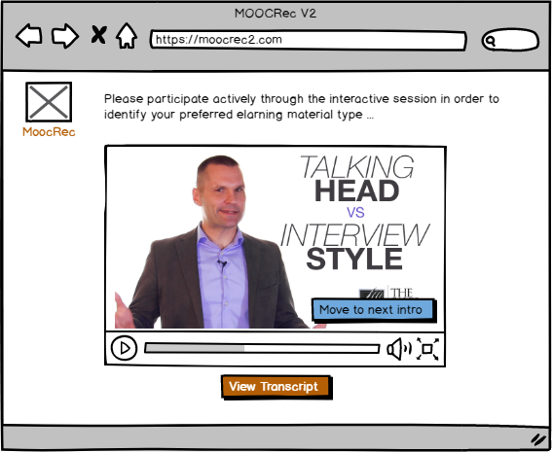
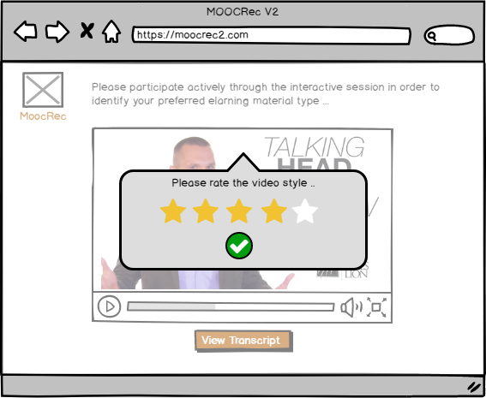
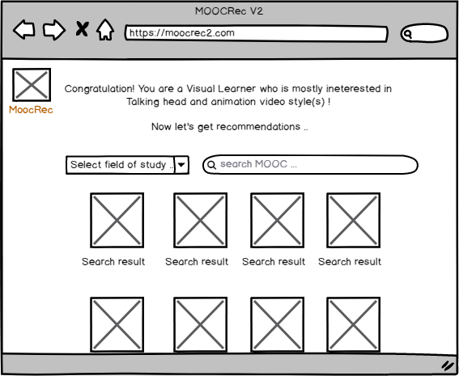
External Interfaces
User Interfaces
Anthropomorphic Approach
Cognitive Approach
Affordance
Constraints
Attention and Workload Models

Slide 14
External Interfaces
Hardware interfaces
100Mbit Network Interface
EC2 instance with below specifications.
8GB RAM
8GB internal storage for the operating system
4 or more vCPUs
Software interfaces
Frontend
Google chrome, Firefox, Microsoft Edge, Opera
Backend
Amazon Linux 2 operating system
Java Runtime Environment (JRE 8)
MongoDB
Node.js API of MoocRec V2

Slide 15
Limitations
Memory constraints
Server-side RAM should be 8 GB or higher
Client-side RAM should be 4 GB or higher
Performance constraints
Browser should not be tasked with heavy performance activities during system usage
Browser activity must be recorded with a minimum hit on browser performance.
Design constraints
Intro session only consists of video styles which are recognized by MOOCRec 2

Slide 16
Testing proposed approach
HCI evaluation method | Technique used | Test carried out
Evaluating implementations | Experimental evaluation | System is tested with real user participation
Query techniques | Questionnaire | Real users fill ILS questionnaire
Observational methods | Think aloud | User is asked to describe what he thinks about his preference of video segments
Evaluating implementations | Experimental evaluation | Test ; if system result = ILS questionnaire result if users actual preferred video style = video style identified by the system

Slide 17
MOOC Rec v2
Analyzing and classifying complex mooc video production styles

Slide 18
Knowledge Gap
Research problem
There are many types of MOOC video production styles.
People need to find their video of interest by going through many videos.
MOOCREC V1 has classified only 3 types of styles.
Solution
Classification of newer and complex video production styles.
Analyze MOOC videos with multiple production styles and get the composition.

Slide 19
Functional Requirements
Extracting videos from the MOOC sources using web crawler.
Splitting a video into Image Frames.
Classification of fragmented Image into a production style
Determine the composition of a video by calculating the composition of each production style.

Slide 20
External Interfaces
Hardware Interfaces
6GB of RAM.
Internet connection with more than 60 Mb/s speed.
GPU with 2GB memory.
Software Interfaces
TensorFlow
Python 3.7
Keras
Communication Interfaces
A network adaptor which support at least 60 Mb/s network speed.

Slide 21
Limitations
6GB of RAM
Internet connection of 60 Mb/s speed.
GPU

Slide 22
MOOC Rec v2
Analyzing forums to aid in Mooc Recommendation

Slide 23
Knowledge Gap
Problems/Limitations/Potential Improvements – In Mooc Rec v1
Reviews & Ratings are not considered
Learner's need to be able to find MOOCs which have high forum activity if they require
Solution
Both these limitations can be overcome by analyzing forums.
(Contd. on the next slide)

Slide 24
Solution Contd.
There are 2 types of threads
Review Threads (General Threads)
Sentiments can be used to get a rating
Can be used along with normal ratings to get a new rating
Technical Threads
Meta data can be analyzed to get a forum activity score
Forum activity score can be used to recommend MOOCs to users who are interested in participating in forums

Slide 25
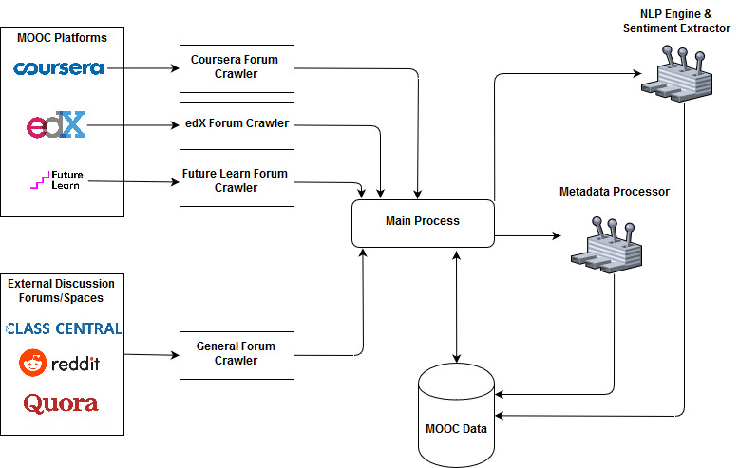
System Design

Slide 26
Functional Requirements
Gather online forum data from Coursera, FutureLearn and Edx
Additionally external forum sites will also be analyzed to get additional information (Reddit, Quora)
Analyze Sentiments of Review-Type Forums
Finding out how positve/negative a review-post is (Processed on GCP or locally)
Normalize sentiment scores
Use sentiment score along with normal rating to produce a new rating
Use new rating when recommending MOOCs
Analyze Meta-Data of Technical Forums
Based on certain attributes – Date Posted, No. Of unique users, Last active, …
Normalize calculated scores
Use forum activity score when recommending MOOCs to users who prefer it

Slide 27
External Interfaces
Hardware Interfaces
A network adapter which supports at least 60Mb/s of data transfer
Software Interfaces
Python 3.7
MongoDB
Google Cloud Platform
Communication Interfaces
An internet connection of at least 60Mb/s for proper functionality

Slide 28
Limitations
A network adapter which supports at least 60Mb/s of data transfer
At least 250GB of storage – Hard disk or SSD
At least 8GB of memory (RAM)

Slide 29
Non-Functional Requirements
Reliability
Maintainability
Scalability
Availability
Notes:
More important than performance because forum related data is not very volatile and is not required to be refreshed at high frequency.

Slide 30
Thank You
Notes:
More important than performance because forum related data is not very volatile and is not required to be refreshed at high frequency.

